Slide 1

Chapter 7 Part 3
Introduction to Structured Query Language (SQL)
The slides in this presentation have been adapted from slides provided with the textbook, Database Systems: Design, Implementation, and Management,
12E, Cornel and Morris, Copyright © 2017 Cengage Learning.

Slide 2
Learning Objectives
Use SQL to retrieve data in sorted order
Write SELECT queries that group data based on common values
Create SELECT queries that join tables for listing of related data
Copyright © 2017 Cengage Learning
2

Slide 3
Additional SELECT Query Keywords
Logical operators work well in the query environment
SQL provides useful functions that:
Count
Find minimum and maximum values
Calculate averages, etc.
SQL allows user to limit queries to:
Entries having no duplicates
Entries whose duplicates may be grouped
Copyright © 2017 Cengage Learning
3

Slide 4
Ordering a Listing
ORDER BY clause is useful when listing order is important
Syntax:
SELECT columnlist
FROM tablelist
[WHERE conditionlist]
[ORDER BY columnlist [ASC | DESC]];
Ascending order by default
Copyright © 2017 Cengage Learning
4

Slide 5
Order By Examples
SELECT P_CODE, P_DESCRIPT, P_INDATE, P_PRICE
FROM PRODUCT
ORDER BY P_PRICE;
SELECT P_CODE, P_DESCRIPT, P_INDATE, P_PRICE
FROM PRODUCT
ORDER BY P_PRICE DESC;
SELECT EMP_LNAME, EMP_FNAME, EMP_INITIAL, EMP_AREACODE, EMP_PHONE
FROM EMPLOYEE
ORDER BY EMP_LNAME, EMP_FNAME, EMP_INITIAL;
SELECT P_DESCRIPT, V_CODE, P_INDATE, P_PRICE
FROM PRODUCT
WHERE P_INDATE < '21-JAN-2012'
AND P_PRICE <= 50.00
ORDER BY V_CODE, P_PRICE DESC;
Copyright © 2017 Cengage Learning
5

Slide 6
Listing Unique Values
DISTINCT clause produces list of only values that are different from one another
Example:
SELECT DISTINCT V_CODE
FROM PRODUCT;
Access places nulls at the top of the list
Oracle places it at the bottom
Placement of nulls does not affect list contents
Copyright © 2017 Cengage Learning
6

Slide 7
Listing Unique Values
LISTING UNIQUE VALUES (ROWS!)
SELECT DISTINCT V_CODE FROM PRODUCT;
SELECT DISTINCT V_STATE FROM VENDOR;
UNIQUE ROWS (VALUES COMBINATIONS)
SELECT DISTINCT V_STATE, V_NAME FROM VENDOR;
SELECT DISTINCT V_STATE, V_AREACODE FROM VENDOR;
Copyright © 2017 Cengage Learning
7

Slide 8
Aggregate Functions
COUNT function tallies number of non-null values of an attribute
Takes one parameter: usually a column name
MAX and MIN find highest (lowest) value in a table
Compute MAX value in inner query
Compare to each value returned by the query
SUM computes total sum for any specified attribute
AVG function format is similar to MIN and MAX
Copyright © 2017 Cengage Learning
8

Slide 9
Count Query Examples
- Q: How many vendors provide products?
- COUNT(column) counts the not null values in column
SELECT COUNT(DISTINCT V_CODE) FROM PRODUCT;
- COUNT(*) counts the number of rows returned
SELECT COUNT(*) FROM (SELECT DISTINCT V_CODE FROM PRODUCT);
- Q: How many vendors (unique vendors) have products with price < 10?
SELECT COUNT(DISTINCT V_CODE)
FROM PRODUCT
WHERE P_PRICE <= 10.00
- Q: How many products with price < 10?
SELECT COUNT(*) FROM PRODUCT
WHERE P_PRICE <= 10.00
Copyright © 2017 Cengage Learning
9

Slide 10
Max/Min Examples
Q: What product(s) have a price equal to the maximum product price?
SELECT P_CODE, P_DESCRIPT, P_PRICE
FROM PRODUCT
WHERE P_PRICE = (SELECT MAX(P_PRICE) FROM PRODUCT)
- Q: What product(s) have the highest inventory value?
SELECT *
FROM PRODUCT
WHERE P_QOH * P_PRICE = (SELECT MAX(P_QOH * P_PRICE) FROM PRODUCT)
Copyright © 2017 Cengage Learning
10

Slide 11
Sum and Avg Examples
- Q: How much is the total customer balance?
SELECT SUM(CUS_BALANCE) AS TOTBALANCE FROM CUSTOMER;
- Q: How much is the total value of our product inventory?
SELECT SUM(P_QOH*P_PRICE) AS TOTVALUE;
FROM PRODUCT
- Q: What is the average product price?
SELECT AVG(P_PRICE) FROM PRODUCT;
- Q: What products have a price that exceeds the average product price?
SELECT P_CODE, P_DESCRIPT, P_QOH, P_PRICE, V_CODE
FROM PRODUCT
WHERE P_PRICE > (SELECT AVG(P_PRICE) FROM PRODUCT)
ORDER BY P_PRICE DESC;
Copyright © 2017 Cengage Learning
11

Slide 12
Grouping Data
Frequency distributions created by GROUP BY clause within SELECT statement
Syntax:
SELECT columnlist
FROM tablelist
[WHERE conditionlist]
[GROUP BY columnlist]
[HAVING conditionlist]
[ORDER BY columnlist [ASC | DESC] ] ;
Copyright © 2017 Cengage Learning
12

Slide 13
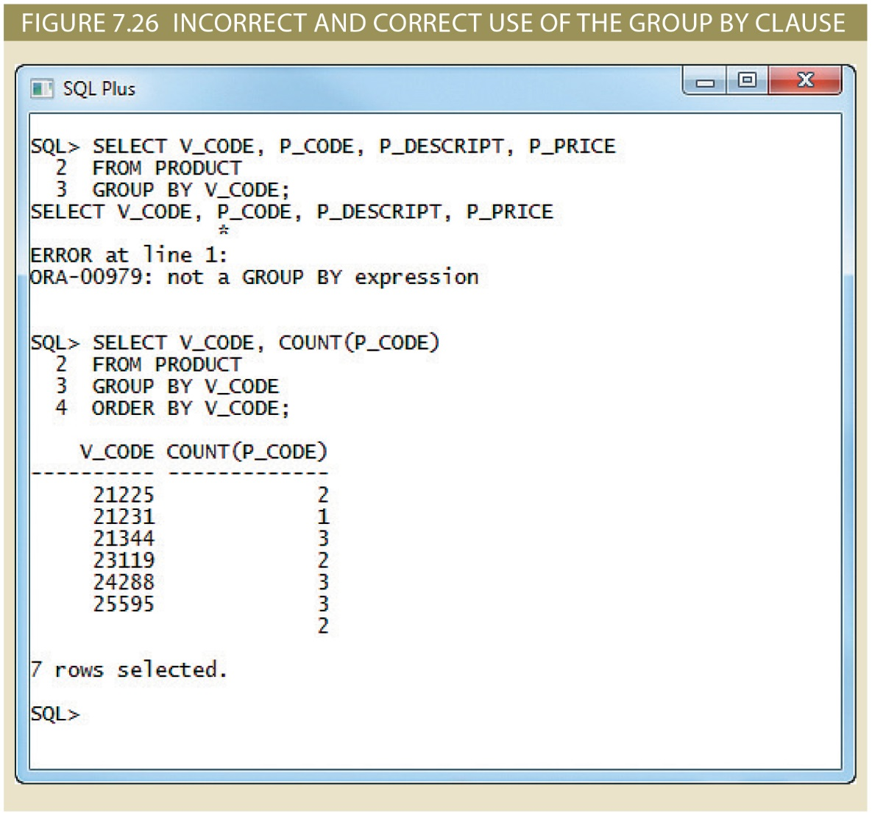
Copyright © 2017 Cengage Learning
13

Slide 14
Simple Group By
- Q: What is the minimum price for each sale code?
SELECT P_SALECODE, MIN(P_PRICE)
FROM PRODUCT
GROUP BY P_SALECODE
- Q: What is the average price for each sale code?
SELECT P_SALECODE, AVG(P_PRICE)
FROM PRODUCT
GROUP BY P_SALECODE
- How many products each vendor provides?
SELECT V_CODE, COUNT(DISTINCT P_CODE)
FROM PRODUCT
GROUP BY V_CODE
Copyright © 2017 Cengage Learning
14

Slide 15
GROUP BY WITH HAVING CLAUSE
Q: List the number of products by vendor with the average price, include only the rows with price below 10.00.
SELECT V_CODE, COUNT(DISTINCT P_CODE), AVG(P_PRICE)
FROM PRODUCT
GROUP BY V_CODE;
SELECT V_CODE, COUNT(DISTINCT P_CODE), AVG(P_PRICE)
FROM PRODUCT
GROUP BY V_CODE
HAVING AVG(P_PRICE) < 10;
Copyright © 2017 Cengage Learning
15

Slide 16
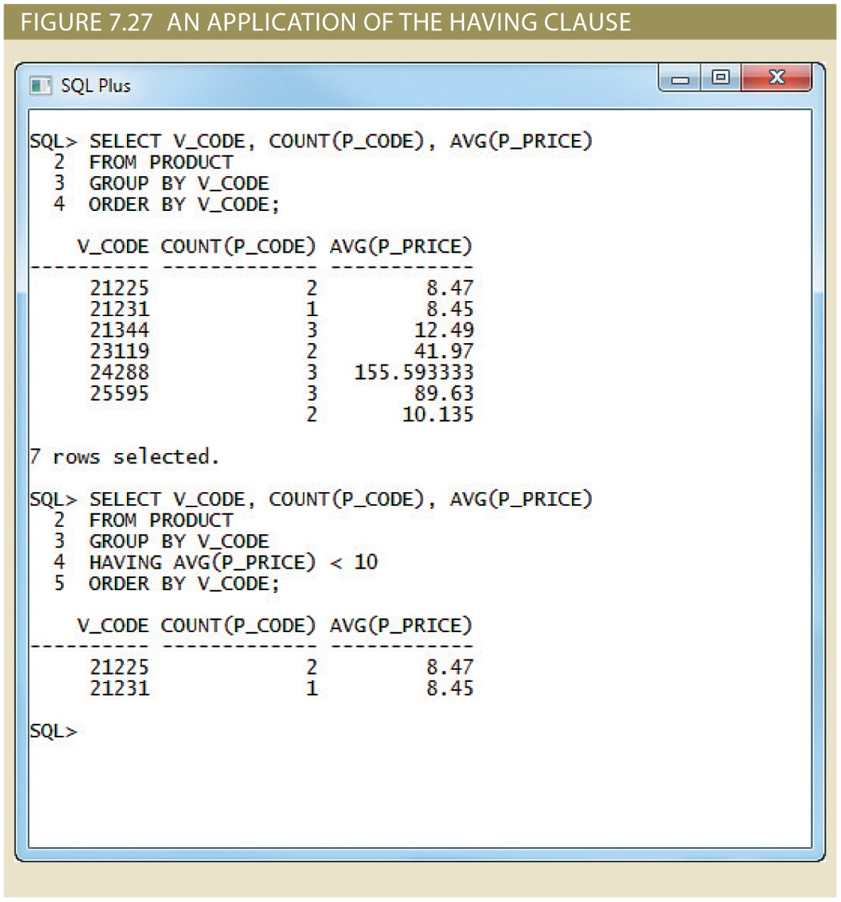
Copyright © 2017 Cengage Learning
16

Slide 17
Joining Database Tables
Joining tables is the most important distinction between relational database and other DBs
Join is performed when data are retrieved from more than one table at a time
Equality comparison between foreign key and primary key of related tables
Join tables by listing tables in FROM clause of SELECT statement
DBMS creates Cartesian product of every table
Copyright © 2017 Cengage Learning
17

Slide 18
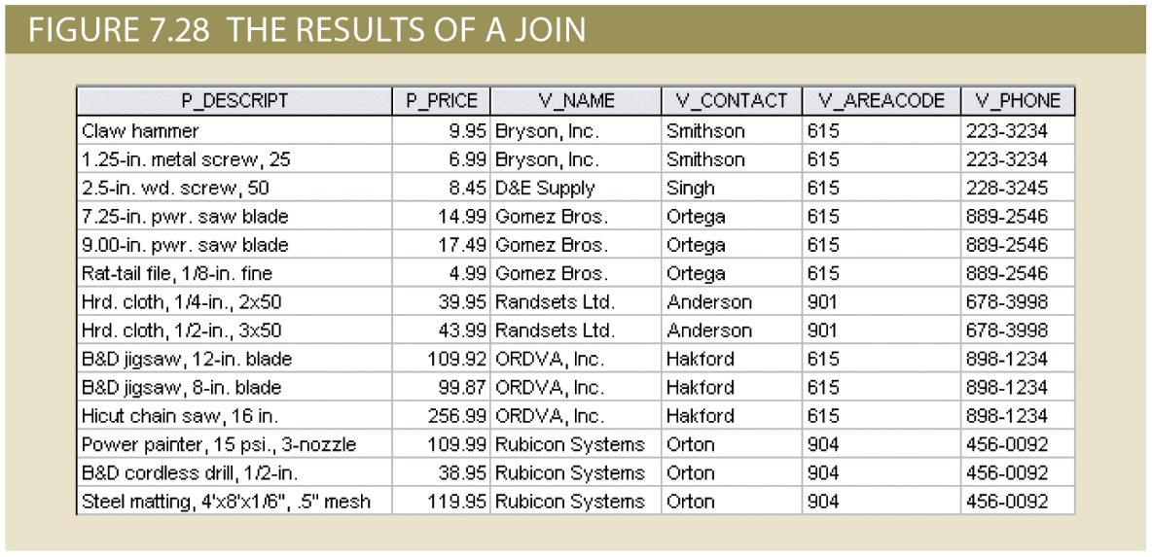
Join Examples
Q: List the product description, price, vendor code, name, contact, area code and phone for each product
SELECT P_DESCRIPT, P_PRICE, VENDOR.V_CODE, V_NAME, V_CONTACT, V_AREACODE, V_PHONE
FROM PRODUCT, VENDOR
WHERE PRODUCT.V_CODE = VENDOR.V_CODE
Copyright © 2017 Cengage Learning
18

Slide 19
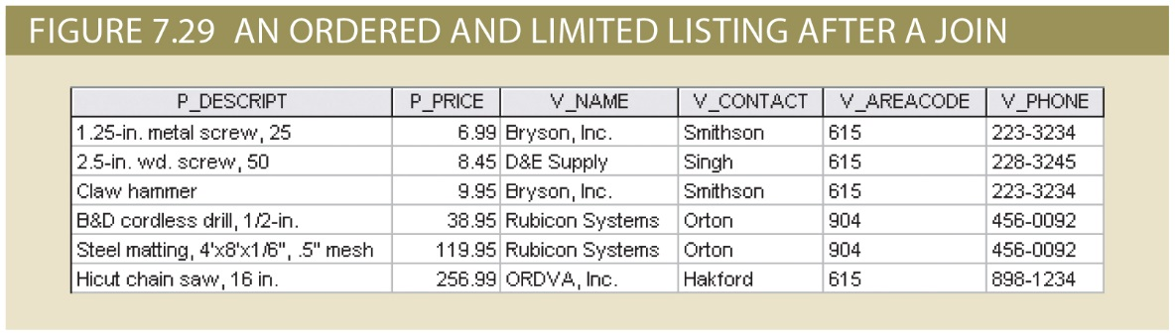
Join Examples
Q: Ordered by P_PRICE
SELECT P_DESCRIPT, P_PRICE, VENDOR.V_CODE, V_NAME, V_CONTACT, V_AREACODE, V_PHONE
FROM PRODUCT, VENDOR
WHERE PRODUCT.V_CODE = VENDOR.V_CODE
ORDER BY P_PRICE
Copyright © 2017 Cengage Learning
19

Slide 20
Join Examples (cont.)
- Q: List products with vendor data for products purchased after 15-JAN-2010
SELECT P_DESCRIPT, P_PRICE, V_NAME, V_CONTACT, V_AREACODE FROM PRODUCT, VENDOR
WHERE PRODUCT.V_CODE = VENDOR.V_CODE
AND P_INDATE > '15-JAN-2012'
- Q: List all invoice data for customer number 10014
SELECT CUS_LNAME, INVOICE.INV_NUMBER, INV_DATE, P_DESCRIPT
FROM CUSTOMER, INVOICE, LINE, PRODUCT
WHERE CUSTOMER.CUS_CODE = INVOICE.CUS_CODE
AND INVOICE.INV_NUMBER = LINE.INV_NUMBER
AND LINE.P_CODE = PRODUCT.P_CODE
AND CUSTOMER.CUS_CODE = 10014
ORDER BY INVOICE.INV_NUMBER
Copyright © 2017 Cengage Learning
20

Slide 21
Joining Tables with an Alias
Alias identifies the source table from which data are taken
Alias can be used to identify source table
Any legal table name can be used as alias
Add alias after table name in FROM clause
SELECT P_DESCRIPT, P_PRICE, V_NAME, V_CONTACT, V_AREACODE, V_PHONE
FROM PRODUCT P, VENDOR V
WHERE P.V_CODE = V.V_CODE
ORDER BY P_PRICE
Copyright © 2017 Cengage Learning
21

Slide 22
Recursive Joins
Alias is especially useful when a table must be joined to itself
Recursive query
Use aliases to differentiate the table from itself
Copyright © 2017 Cengage Learning
22

Slide 23
Recursive Example
- Q: List all employees with their manager's name
SELECT E.EMP_MGR, M.EMP_LNAME,E.EMP_NUM, E.EMP_LNAME
FROM EMP E, EMP M
WHERE E.EMP_MGR=M.EMP_NUM
ORDER BY E.EMP_MGR
Copyright © 2017 Cengage Learning
23

Slide 24
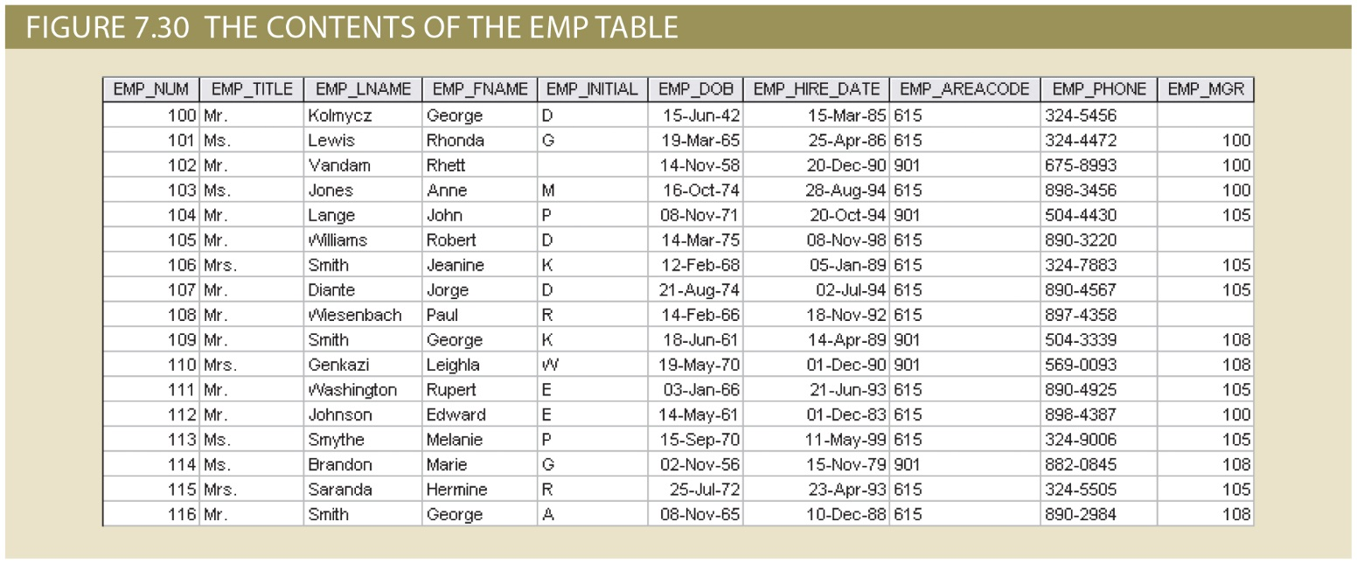
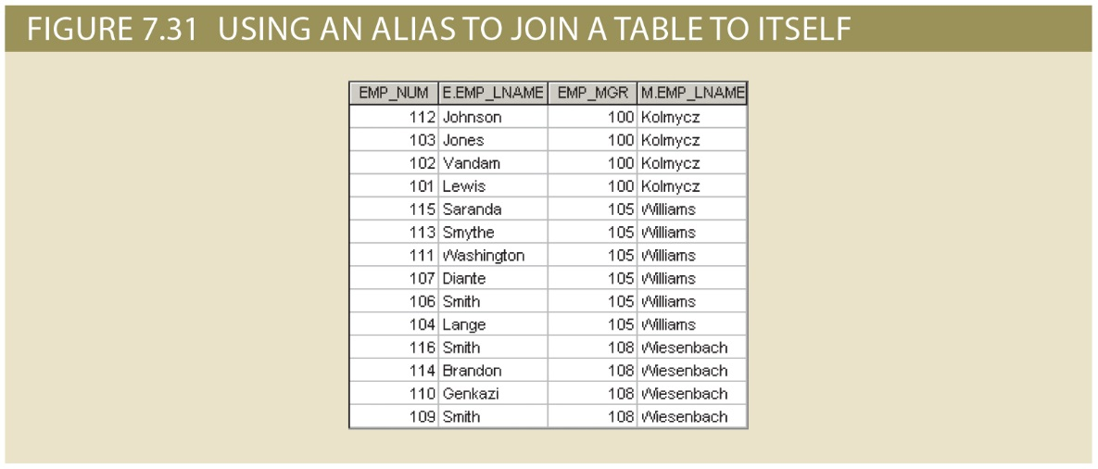
Copyright © 2017 Cengage Learning
24

Slide 25
Summary
Aggregate functions
Special functions that perform arithmetic computations over a set of rows
ORDER BY clause
Used to sort output of SELECT statement
Can sort by one or more columns
Ascending or descending order
Copyright © 2017 Cengage Learning
25

Slide 26
Summary (cont’d.)
Join output of multiple tables with SELECT statement
Use primary key / foreign key combinations to make most joins
Join performed every time you specify two or more tables in FROM clause
Copyright © 2017 Cengage Learning
26

Slide 27
Task
Write a SELECT query that performs a recursive join of the following part table, which shows all the components for a given PART_CODE.
PART (PART_CODE, PART_DESCRIPTION, PART_IN_STOCK, PART_UNITS_NEEDED, PART_OF_PART)
(see page 137 for more information on the table)
Copyright © 2017 Cengage Learning
27

